Slide 1
Ponzi Scheme and Cryptocurrency Crimes
Maram Bani Younes

Slide 2
Contents
What is Ponzi Scheme?
Ponzi scheme collapses
Origins of the Ponzi Scheme
Cryptocurrency Scams
Ponzi Schemes and Cryptocurrency.

Slide 3
Ponzi Scheme
A Ponzi scheme is a type of investment fraud in which investors are promised big profits at little or no risk.
The money is not invested. Rather, the scam artist concentrates on attracting more investors.
A growing number of victims is needed to pay out the supposed profits being distributed to earlier investors.

Slide 4
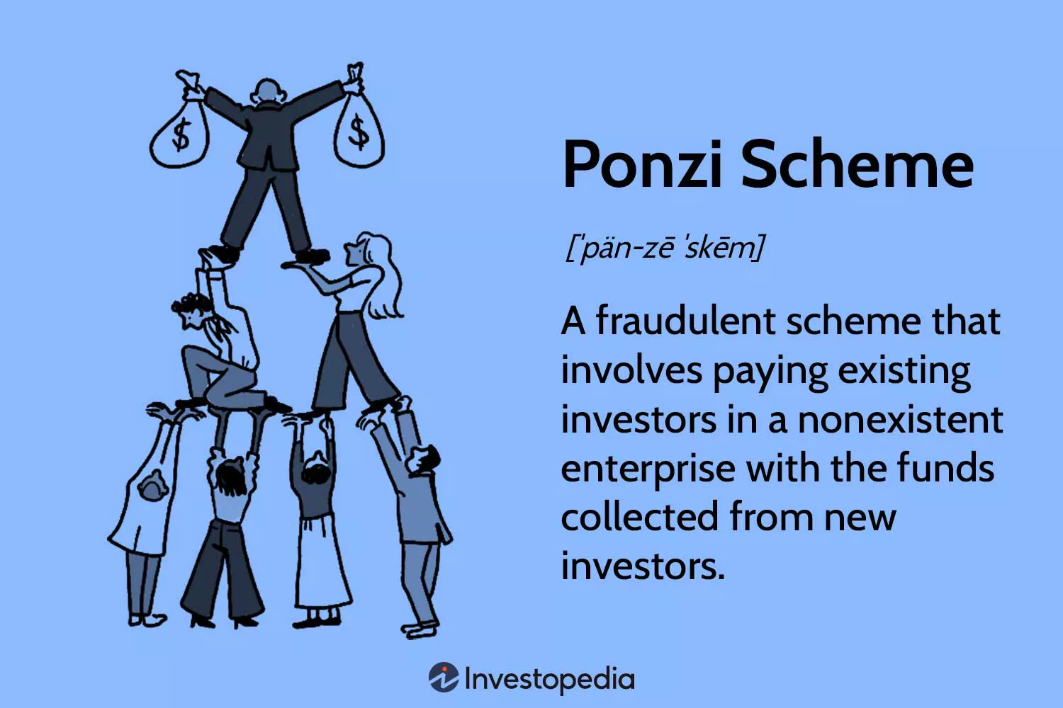
Ponzi Scheme

Slide 5
Ponzi scheme collapses
When the flow of new investment slows, the scam artist doesn't have enough money to pay out those supposed profits. That's when the Ponzi scheme collapses.

Slide 6
Origins of the Ponzi Scheme
The Ponzi scheme got its name in 1920 from a swindler named Charles Ponzi. Cornell Law School Legal Information Institute. "Ponzi Scheme.“
Ponzi became a millionaire by promoting a nonexistent investing opportunity.
Ponzi wasn't the first to perpetrate this type of fraud. Earlier schemes were reported in the 19th century and the methods were dramatized.

Slide 7
Cryptocurrency Scams
A cryptocurrency scam is a fraud involving digital currencies that aims to deceive investors with false promises or to trick them into giving away access to their digital wallets.
Scammers lure victims with the promise of high returns, only to disappear with the investors' money.
Criminals will use legitimate logos copied from government agencies to make them appear authentic.

Slide 8
Cryptocurrency Scams
Scammers can trick victims into sending cryptocurrency, resulting in irreversible financial losses.
Some scams involve stealing personal information, leading to identity theft and further fraud.
Scammers use malware and phishing techniques to compromise wallets and access funds.

Slide 9
Ponzi Schemes and Cryptocurrency.
Ponzi schemes and fake investment opportunities promise high returns but result in total loss.
The lack of regulatory oversight of cryptocurrency makes it challenging to recover stolen funds.

